Slide 1
ApoE4 v/s WT
N = 1 rat per each type
Electrophysiological data analyses
1 day = 9 sessions (4 run and 5 sleep)
Each session = 10 minutes
sleep1
run1
sleep2
run2
sleep3
run3
sleep4
run4
sleep5

Slide 2
ApoE4 v/s WT
N = 1 rat per each type
Electrophysiological data analyses
Average in-field to out-of-field firing rate ratio (on-track)

Slide 3
Average out-of-field firing rate (on-track)

Slide 4
Spatial information

Slide 5
Population vector correlation

Slide 6
N = 71 cells
Theta phase precession
N = 71 cells

Slide 7
Slope (deg/pf)
R2

Slide 8
Theta phase precession across laps with number of cells and spikes down-sampled between the cohorts (n = 20 cells)

Slide 9
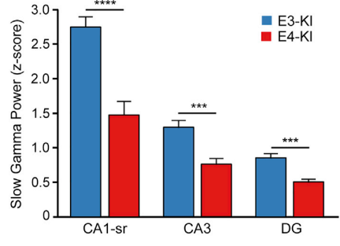
Ripples(SWR)
Slow gamma power during ripples
Replays(population events)
Gillespie et al. 2016

Slide 10
Replay fidelity (SWR)
Replay fidelity (pop Events)

Slide 11
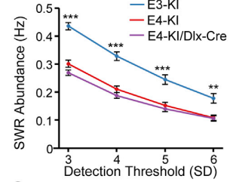
Replay rate (SWR)
Replay rate (pop Events)
Gillespie et al. 2016

Slide 12
ApoE4
Session 1, lap 1
Session 1, lap 2
Session 4, last lap - 1
Session 4, last lap
WT
Session 1, lap 1
Session 1, lap 2
Session 4, last lap - 1
Session 4, last lap
…

Slide 13
ApoE4 - Theta sequences

Slide 14
WT - Theta sequences

Slide 15
Remapping
Familiar environment
Novel environment
ApoE4
1 day = 9 sessions (4 run and 5 sleep)
Each session = 10 minutes
sleep1
run1
sleep2
run2
sleep3
run3
sleep4
run4
sleep5
WT
sleep1
run1
sleep2
run2
sleep3
run3
sleep4
run4
sleep5

Slide 16
Rate maps of CA1 units
ApoE4
WT

Slide 17
Population vector correlation
Between familiar and novel environment runs (run 1 and run 2)

Slide 18
Binned firing rate during Ripples

Slide 19
Normalized binned firing rate during Ripples

Slide 21
Remapping
Familiar environment
Novel environment
ApoE4
1 day = 9 sessions (4 run and 5 sleep)
Each session = 10 minutes
sleep1
run1
sleep2
run2
sleep3
run3
sleep4
run4
sleep5
WT
sleep1
run1
sleep2
run2
sleep3
run3
sleep4
run4
sleep5

Slide 22
Selectivity index
Run 2
Run 4

Slide 23
Selectivity index
Run 2
Run 1

Slide 24
Analyses done by Nick

Slide 25
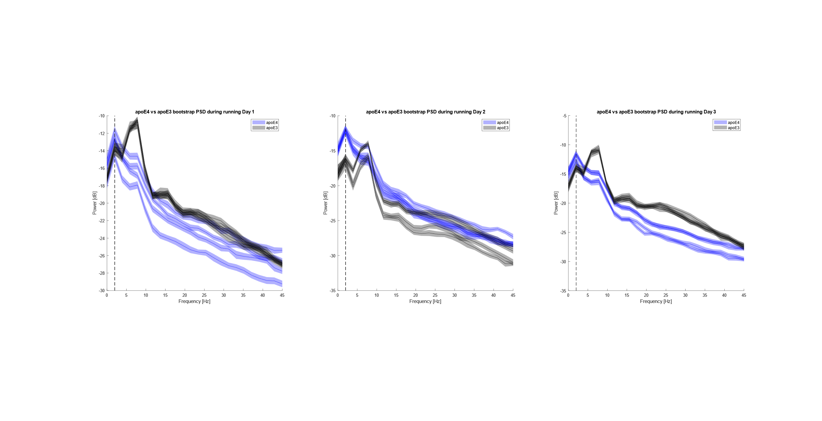
ApoE4 v/s WT
N = (1, 1)
Circle Track
Electrophysiological data analyses
Differences in PSD in ApoE4 model during running behavior (Bootstrap CI)
Day 1
Day 2
Day 3

Slide 26
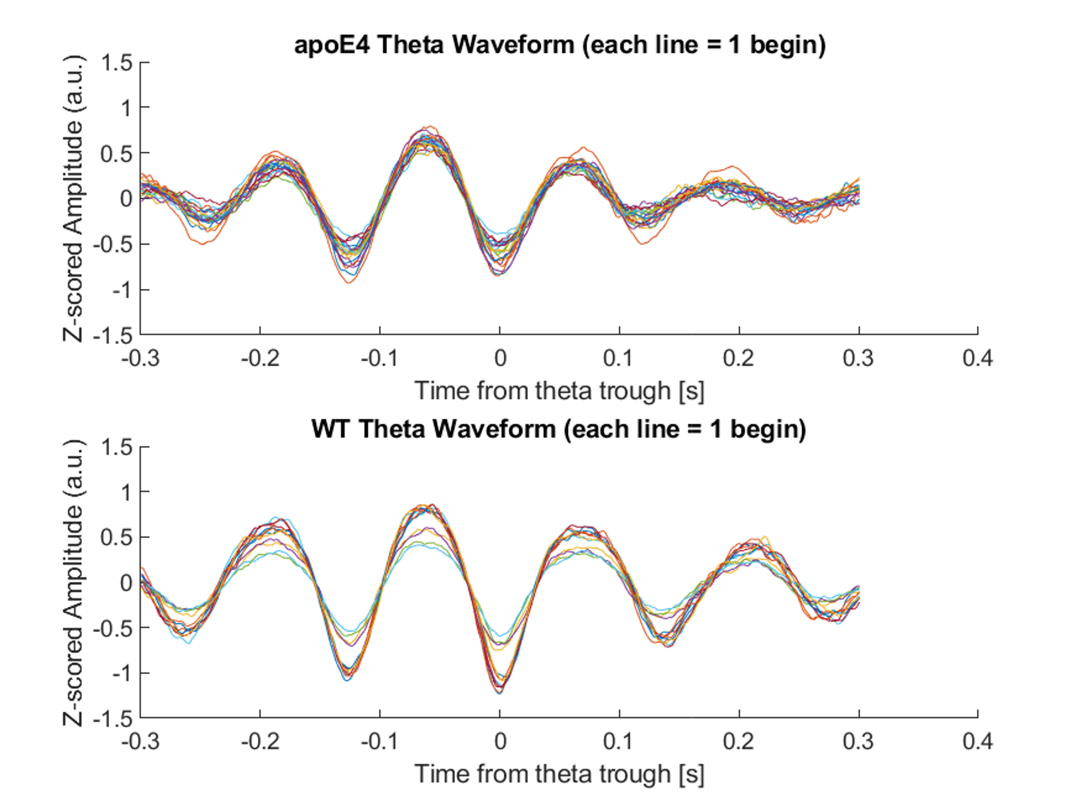
Jitter during “theta mode” in apoE4 model compared to WT

Slide 27
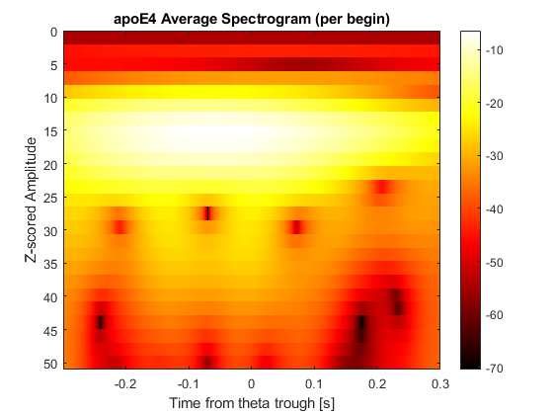
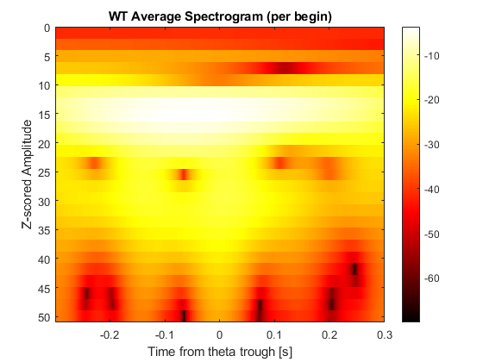
Decreased slow gamma power during “theta mode” in the apoE4 model

Slide 28
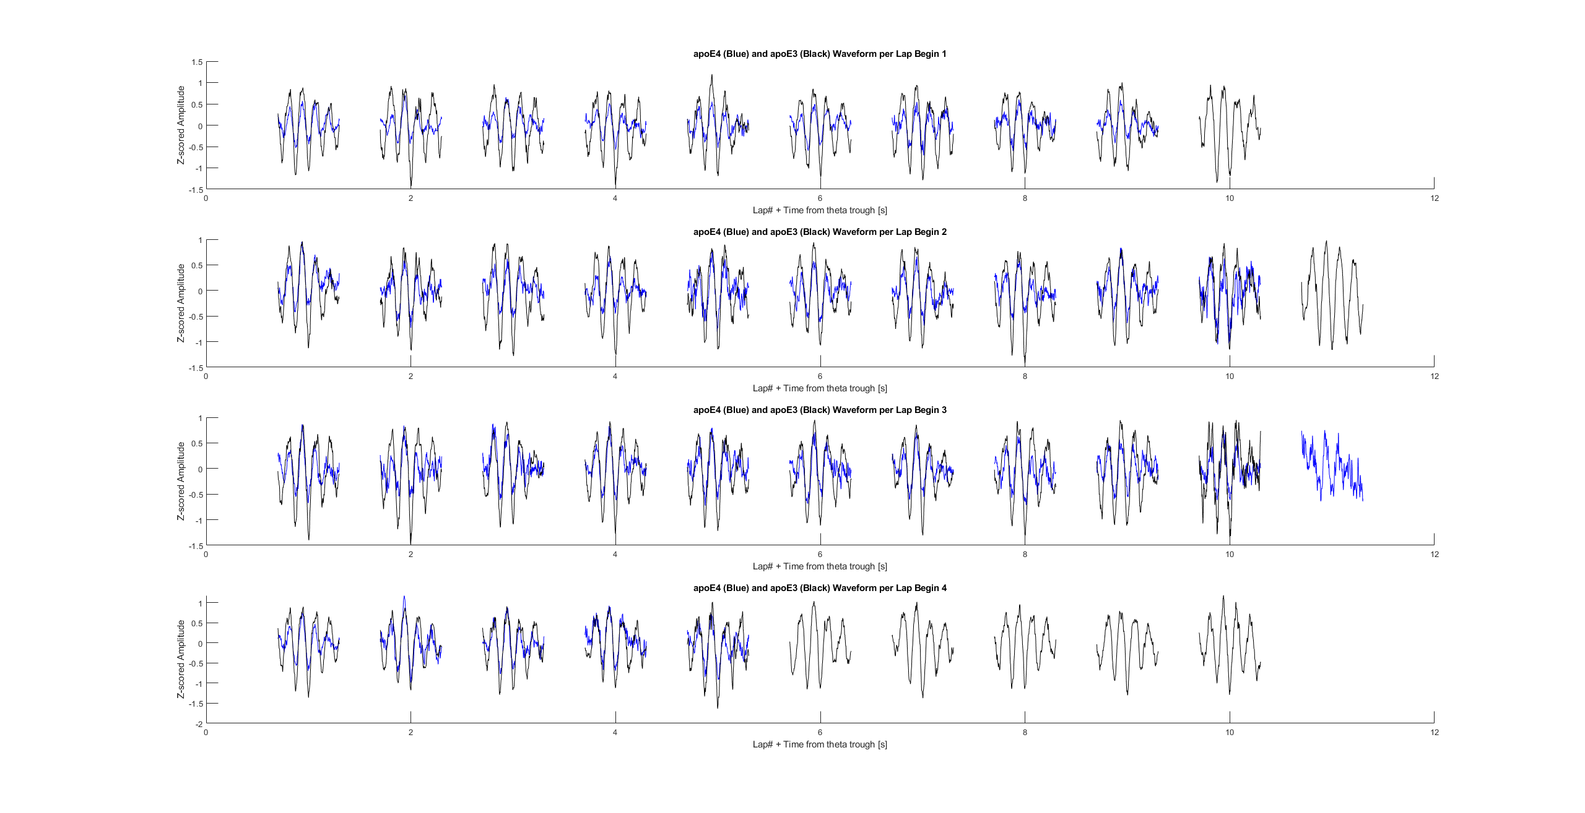
Average theta waveform per lap shows decrease in amplitude => decrease in power seen in the PSD (consistent across days)
Apoe4 – blue
WT – black

Slide 29
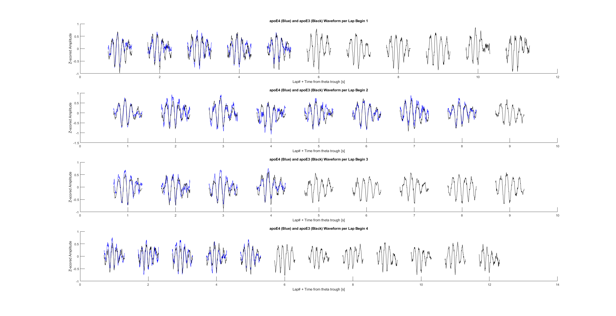
Average theta waveform per lap shows decrease in power (consistent across days)

Slide 30
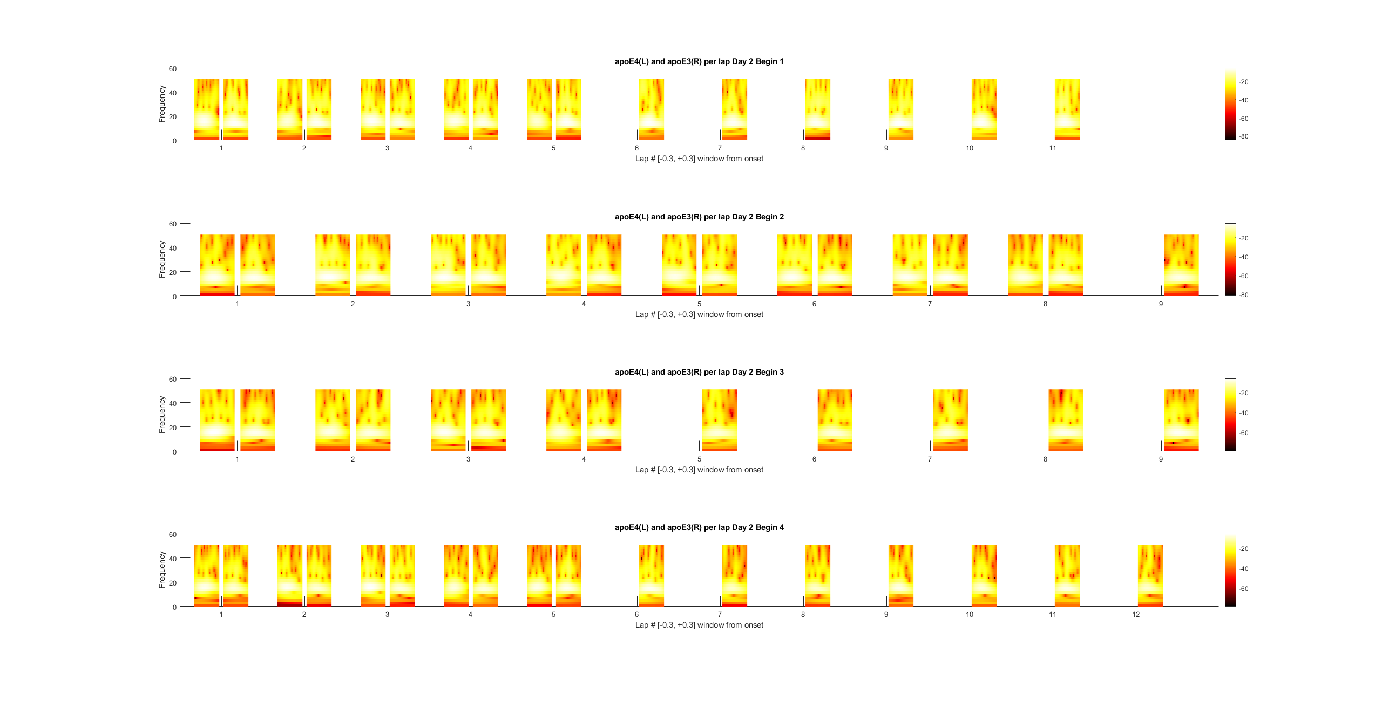
Average theta spectrogram per lap shows decrease in power (consistent across days)

Slide 31
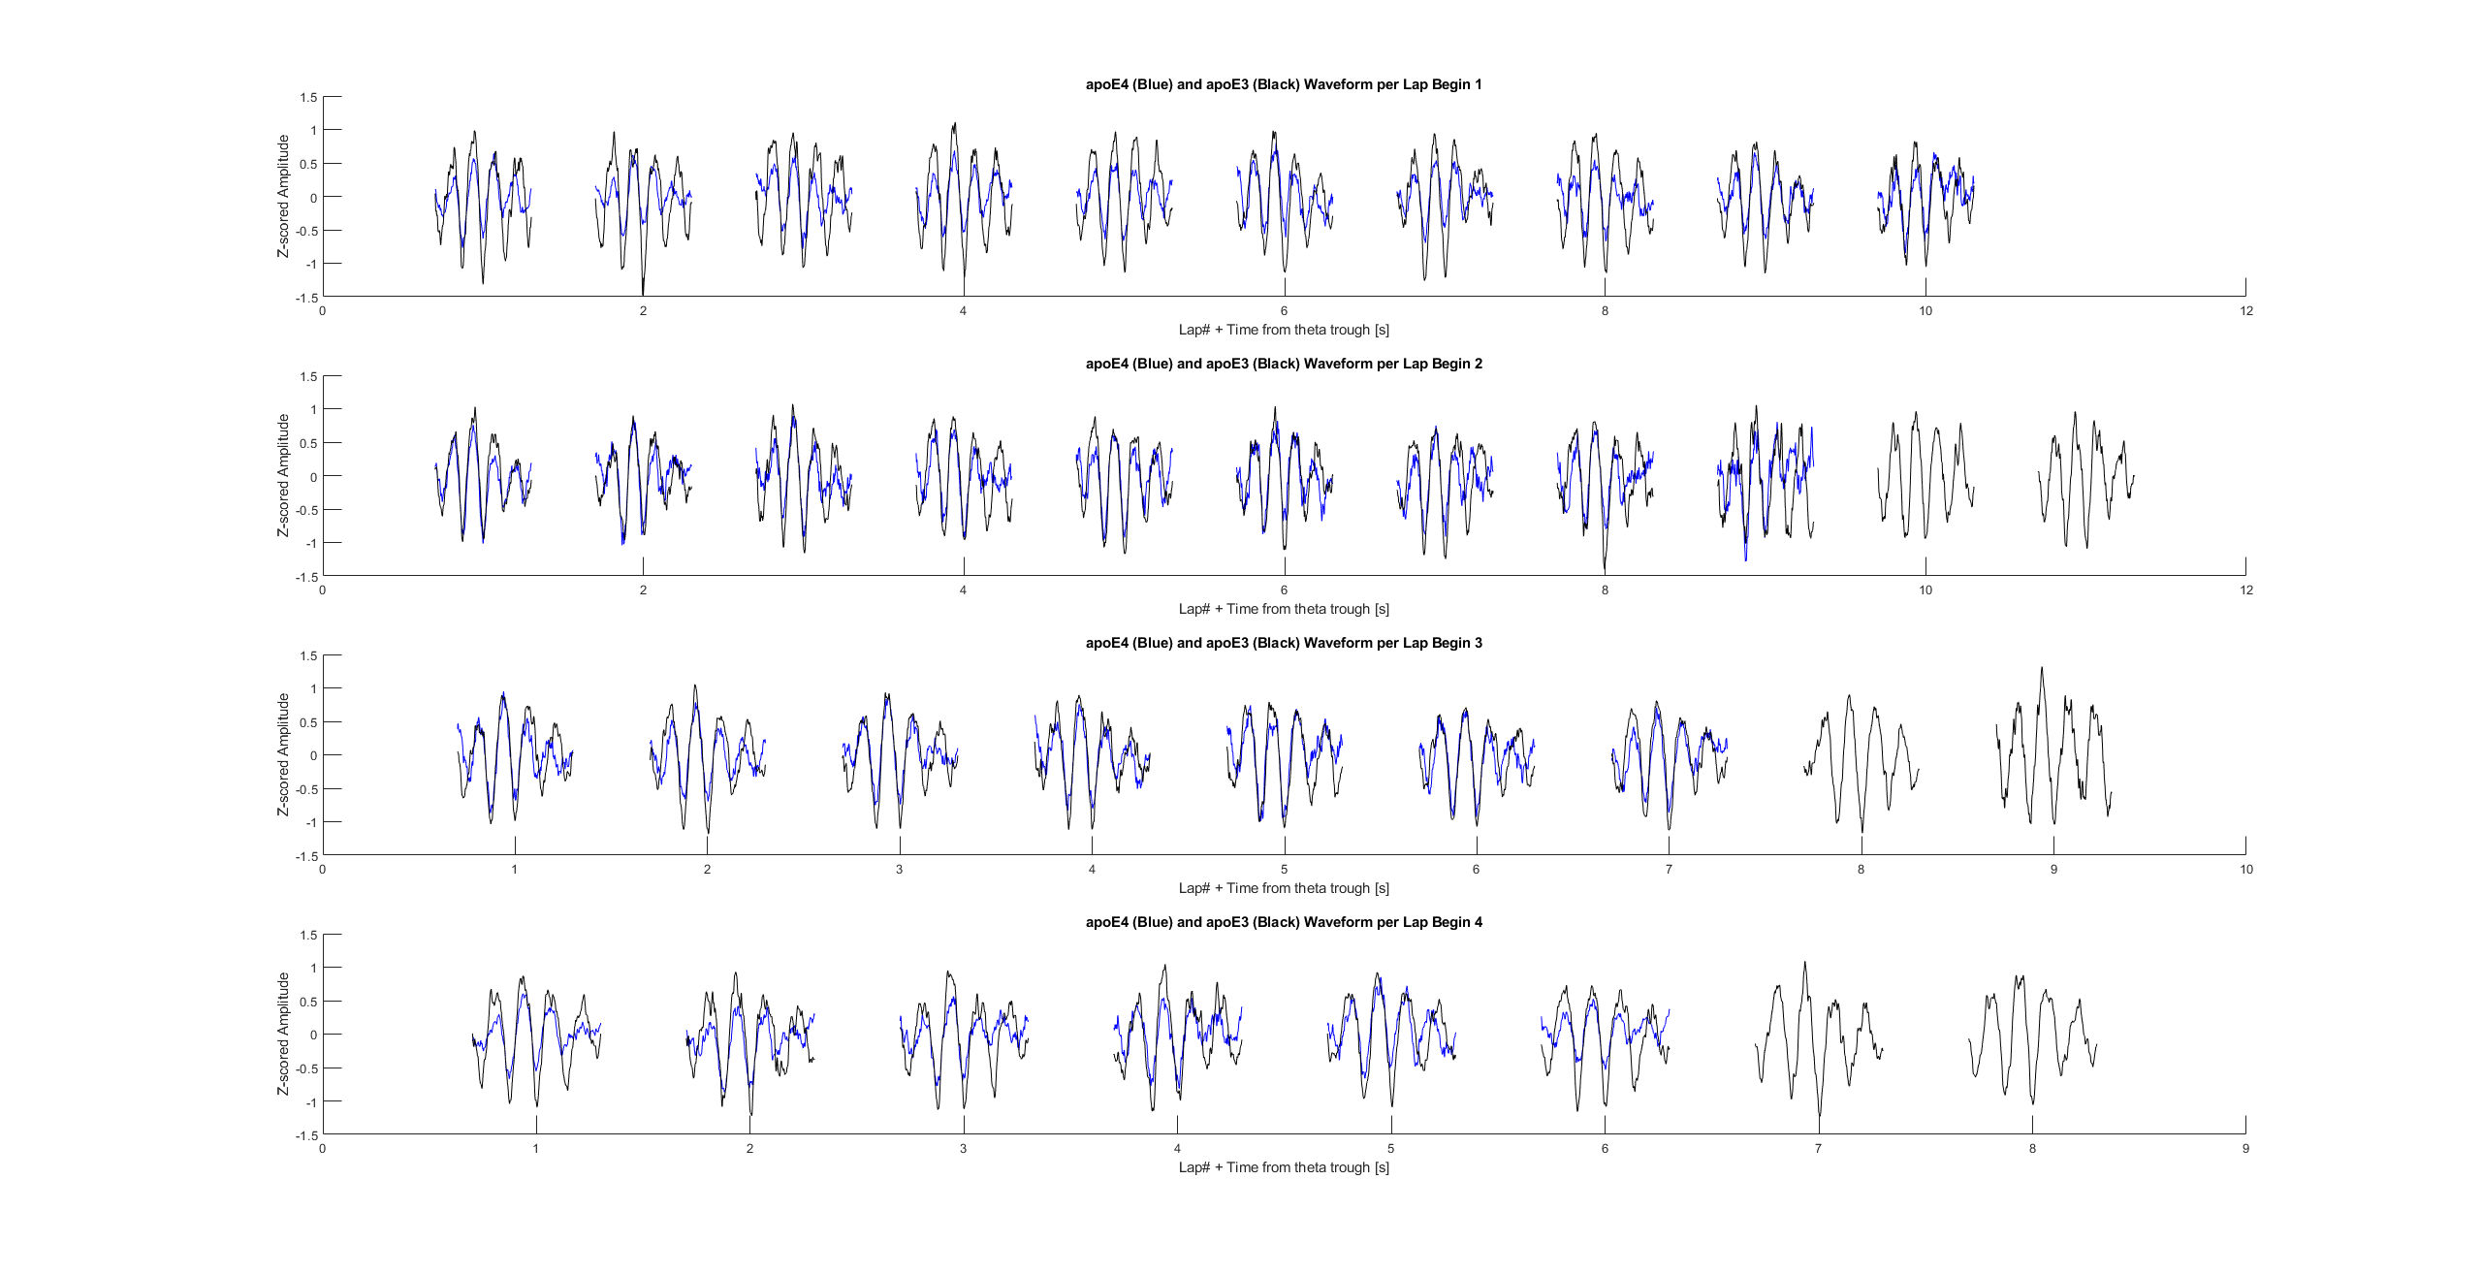
Average theta waveform per lap shows decrease in power (consistent across days)

Slide 32
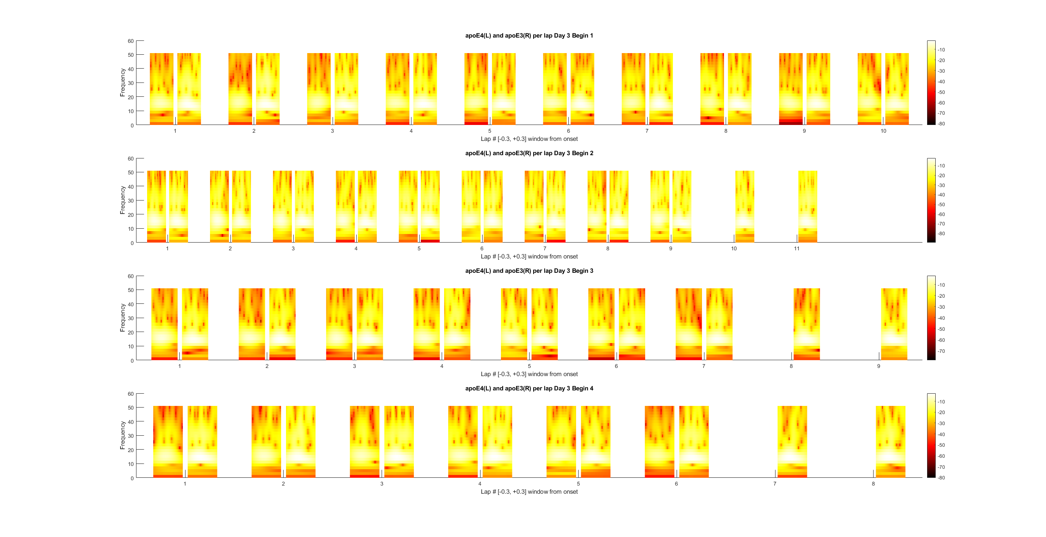
Average theta spectrogram per lap shows decrease in power (consistent across days)

Slide 33
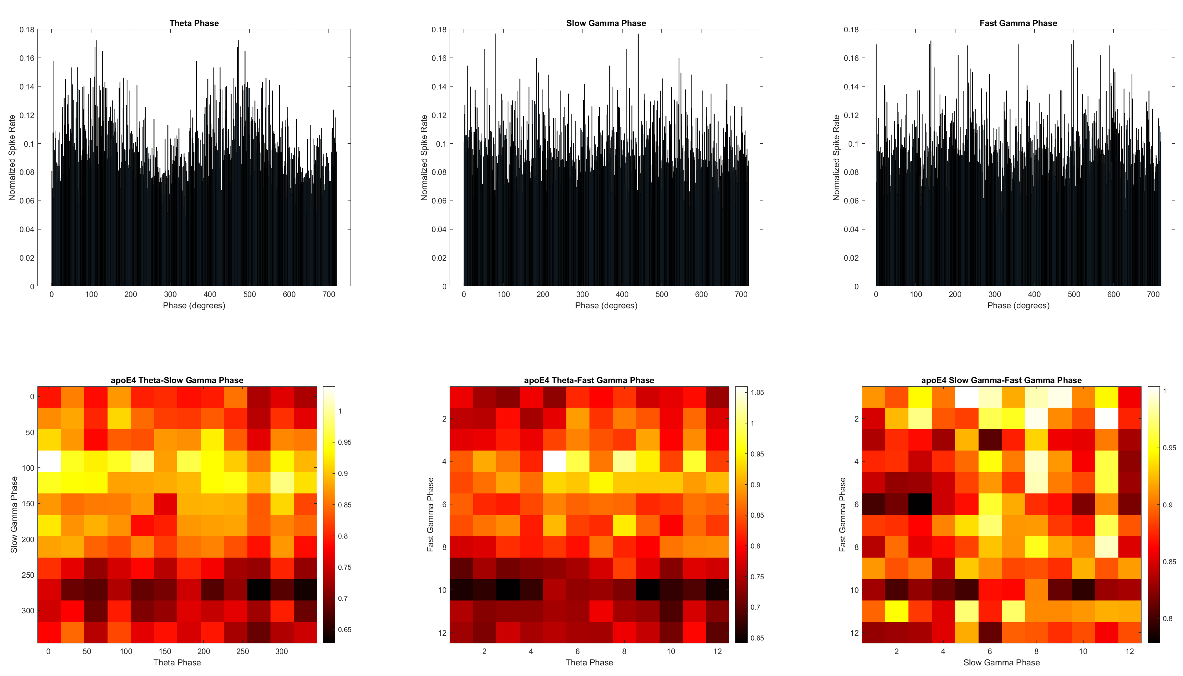
Phase-Phase Synchrony between theta, slow gamma, and fast gamma

Slide 34
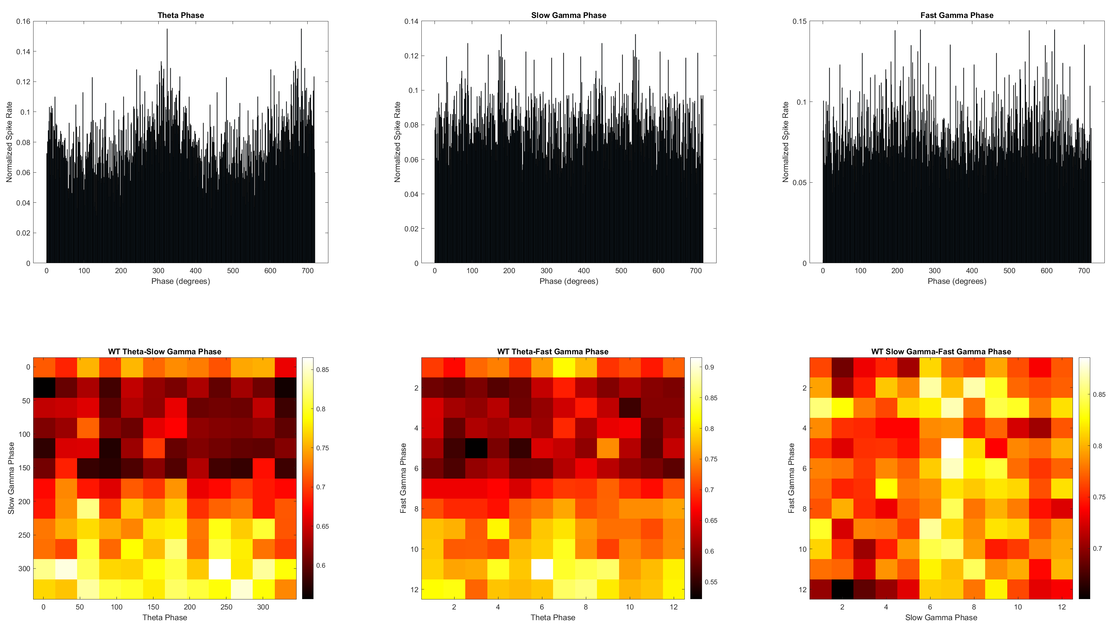
Phase-Phase Synchrony between theta, slow gamma, and fast gamma

Slide 35
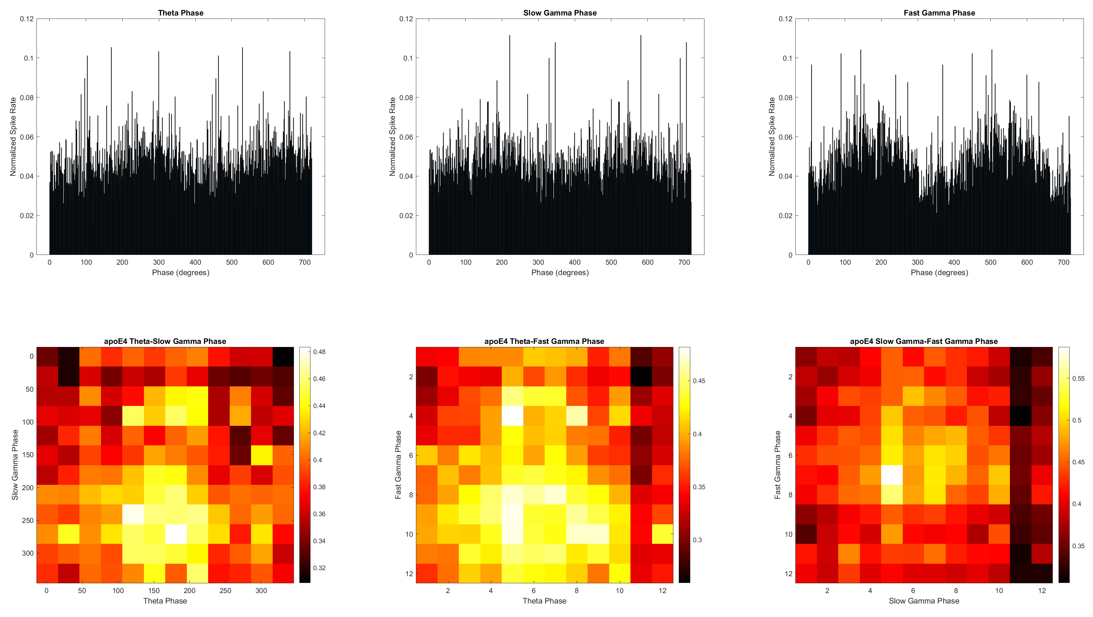
Phase-Phase Synchrony between theta, slow gamma, and fast gamma

Slide 36
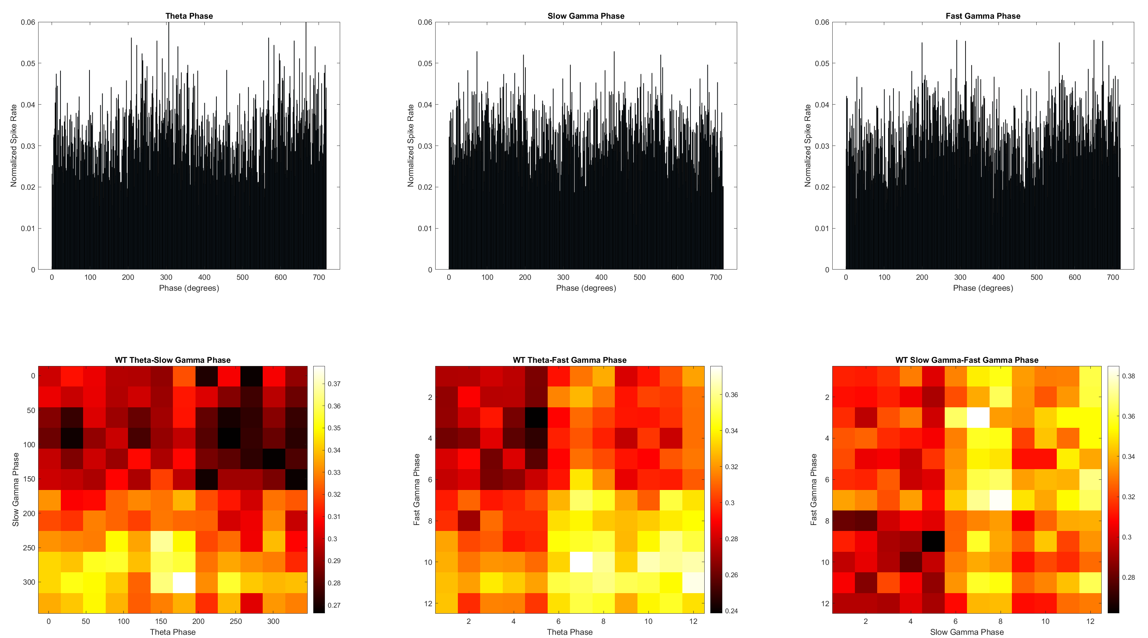
Phase-Phase Synchrony between theta, slow gamma, and fast gamma

Slide 37
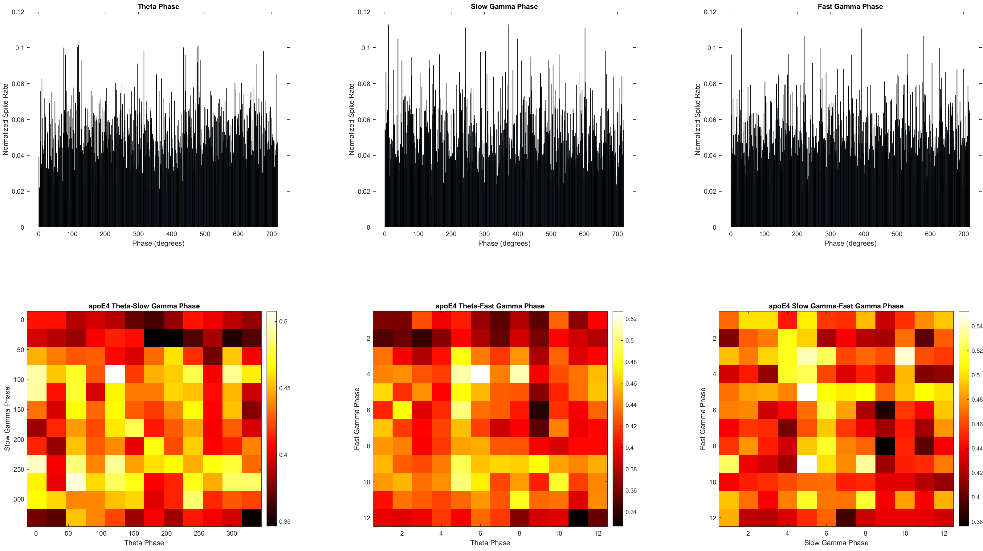

Slide 38
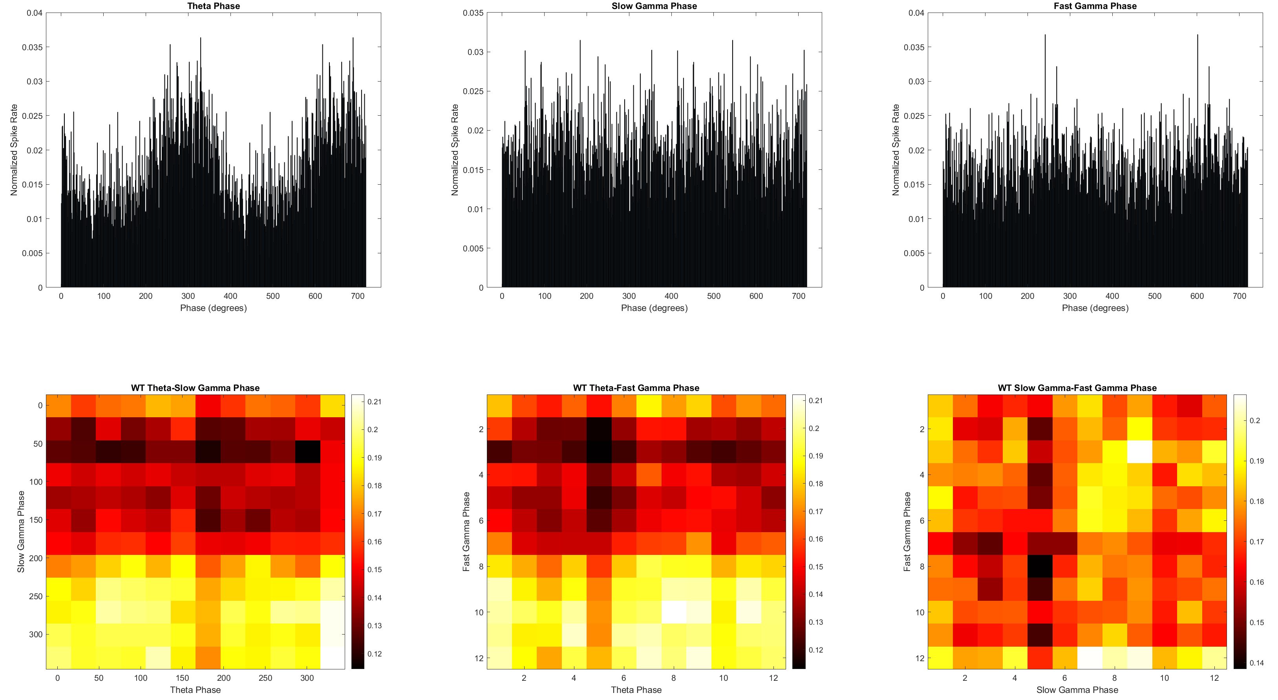
Phase-Phase Synchrony between theta, slow gamma, and fast gamma

